Slide 1

Liver Transplant for MSUD: Outcomes, Challenges, and LONG TERM PERSPECTIVES
George V. Mazariegos
UPMC Children’s Hospital of Pittsburgh
February 22, 2024
Notes:
Es un placer para mí hablar hoy sobre el tema de la evaluación comparativa en el trasplante de hígado pediátrico.

Slide 2
Objectives
Current status and challenges in pediatric (and adult) liver transplantation
Summarize our case experience
Getting to an ideal outcome
Next steps/challenges
  How to provide for a near normal lifetime of care?

Slide 3
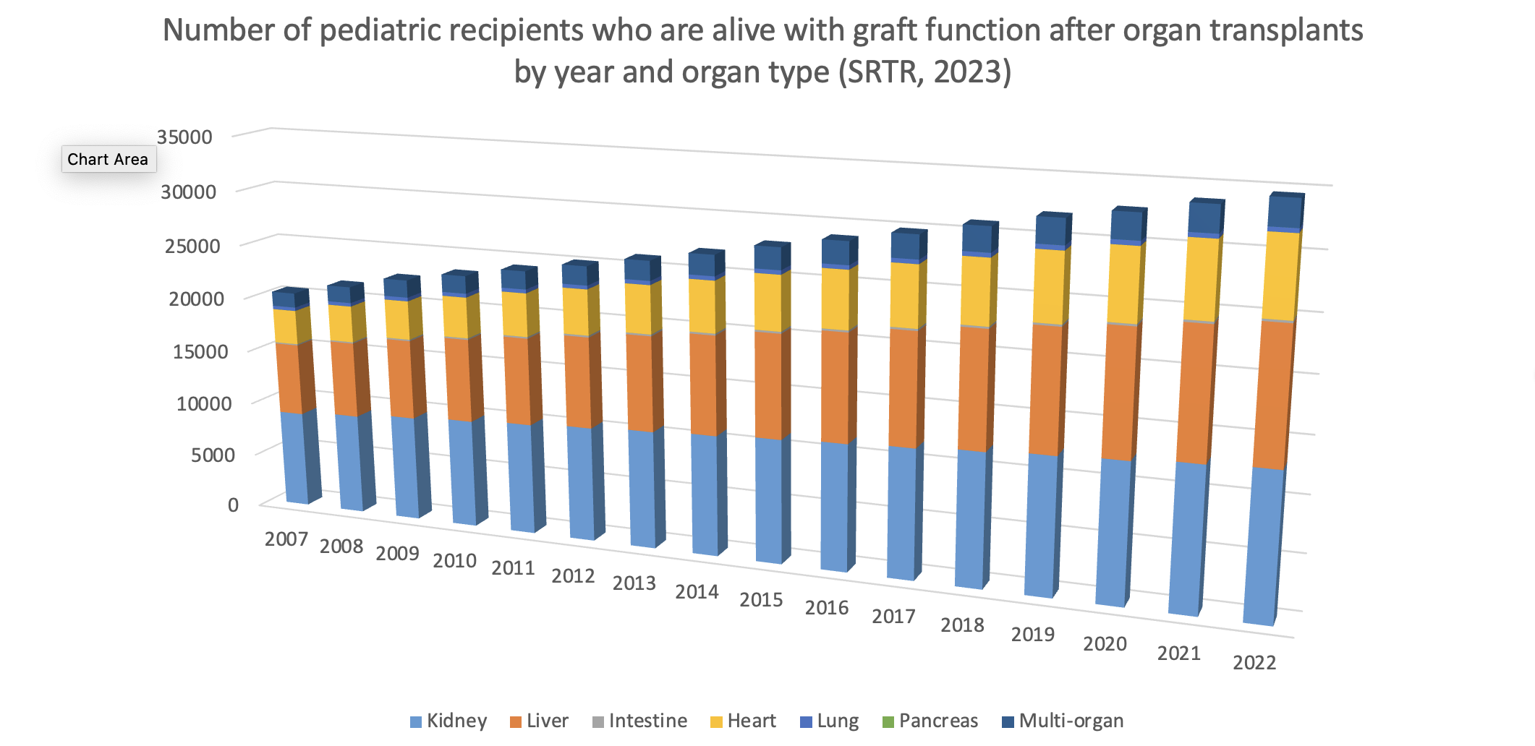

Slide 5
What is the projected outcome for children transplanted today?
30 yr patient and graft survival projected at 80%/69.1%, respectively

Slide 6
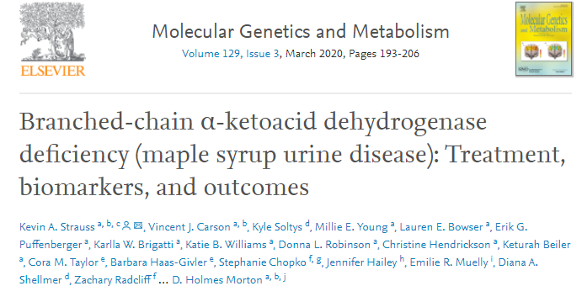
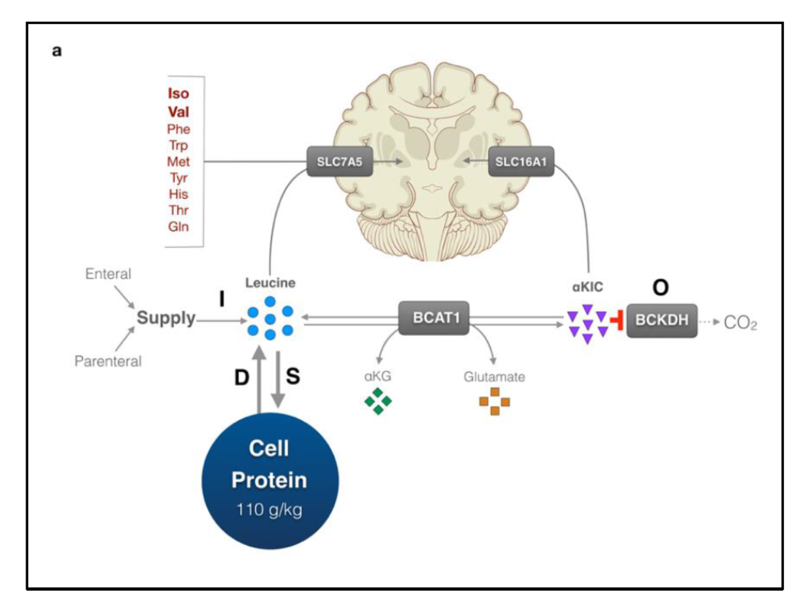
Improved oucomes were key to pushing the boundaries

Slide 7
Overall outcomes
Patient and graft survival
Patient status
Patient survival 98.5 %
Graft survival 97.5 %
  One ReTx
Current Folllowup (n=83)
  Transferred to other center (n=28)
  Lost to followup (n=6)
Morbidity :1 patient with biliary drainage catheter
100% unrestricted diet
No metabolic crises

Slide 8

CHALLENGES UNDER THE SURFACE
HIGH VARIATION IN CRITICAL OUTCOMES
ARE WE MEASURING IDEAL OUTCOMES
CAN WE BETTER STANDARDIZE CARE?

Slide 9
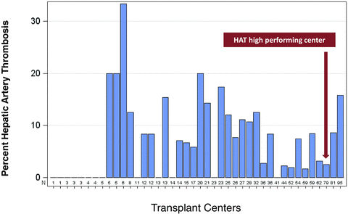
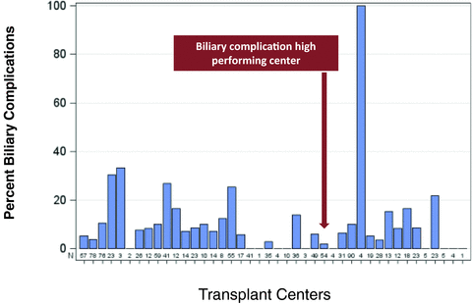
Knowledge gap and variation in critical outcomes
Reducing Pediatric Liver Transplant Complications: A Potential Roadmap for Transplant Quality Improvement Initiatives Within North America
Biliary complication ( LEFT) and Hepatic Arterty Complication ( RIGHT) rates across North American pediatric liver transplant centers.
American Journal of Transplantation, Volume: 12, Issue: 9, Pages: 2301-2306, First published: 06 August 2012, DOI: (10.1111/j.1600-6143.2012.04204.x)
Notes:
Biliary complication rates across North American pediatric liver transplant centers.
Las tasas de complicaciones biliares en los centros de trasplante de hígado pediátrico de América del Norte varían de 2% a casi 100% en este estudio de la Society of Pediatric LIver Transplantation

Slide 10
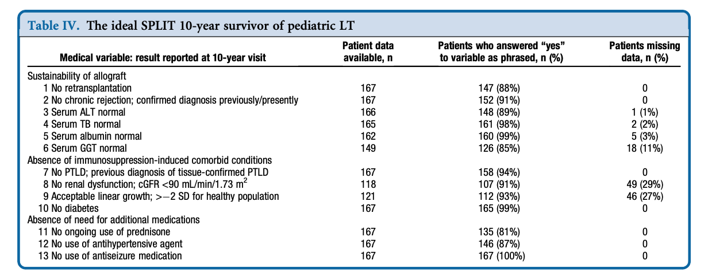
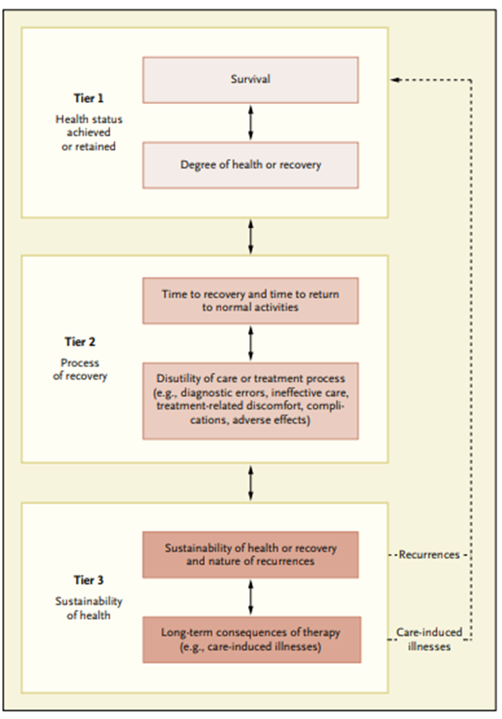
Toward a more wholistic view: the “Ideal outcome” metric
Vicky Ng et al : Health Status of Children Alive 10 years after Pediatric Liver Transplant J Pediatrics 2012: 160-820-6
Notes:
Creo que la audiencia está familiarizada con el concepto de resultados ideales que van más allá de la supervivencia del paciente y del injerto
para incluir métricas específicas de la salud de los órganos, las morbilidades relacionadas con la inmunosupresión y la frecuencia de la monoterapia, por ejemplo.

Slide 11
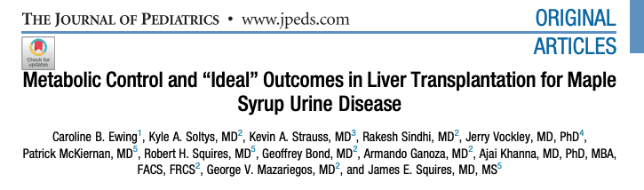
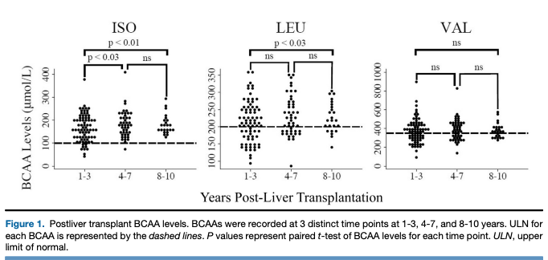

Slide 12
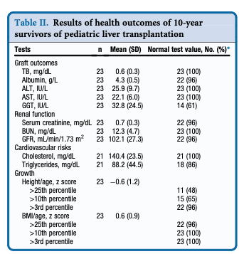
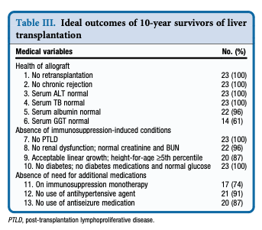
Ideal outcome metrics, MSUD TX, J Peds 2021

Slide 13
Outcome metrics by time post Tx
Criteria | 0-1 Yr post TX | 1</=5 Yr | 5</=10 Yr | >10 Yr
Followup (N) | 6 | 26 | 19 | 29
Followup (YRS) | 0.34 | 2.8 | 7.08 | 14.7
ALT | 34.67(16-58) | 23 (10-48) | 23 (15-70) | 25 (13-107)
GGT | 25.33(10-77) | 14 (8-55) | 27 (10-113) | 22 (4-176)
Tac Mono (n) | 2 | 15 | 14 | 22
Tac Pred (n) | 1 | 0 | 0 | 0
Tac Cellcept(n) | 1 | 10 | 2 | 7
Tac/Cellcept/Pred (n) | 2 | 1 | 3 | 0
GFR | 89.42(80-100.5) | 87.1 (50.84-648) | 102.2 (75.7-361) | 91.2 (59.7-154.5)
Leucine | 235.5 (139-365) | 207 (174-303) | 248 (139-378) | 264 (124-371)

Slide 14
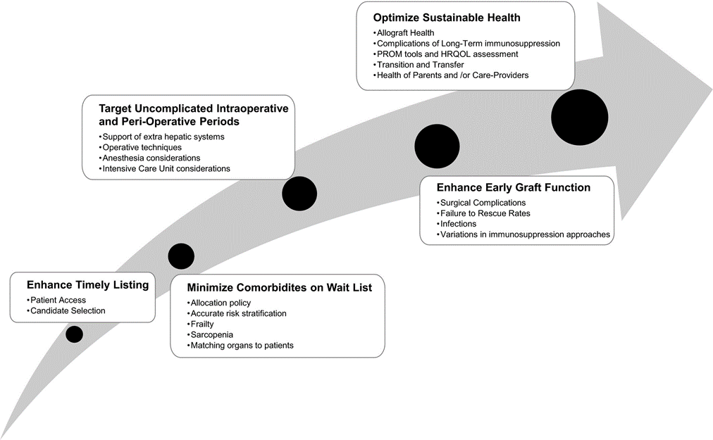
Barriers to Ideal Outcomes
Pediatric Transplantation, Volume: 23, Issue: 6, First published: 25 July 2019, DOI: (10.1111/petr.13537)
Notes:
La vida útil de un paciente pediátrico permite que existan barreras durante la fase previa al trasplante, la fase operativa y luego el postrasplante temprano o a largo plazo.

Slide 15
How do learning systems meet the current health care system needs?

Slide 16
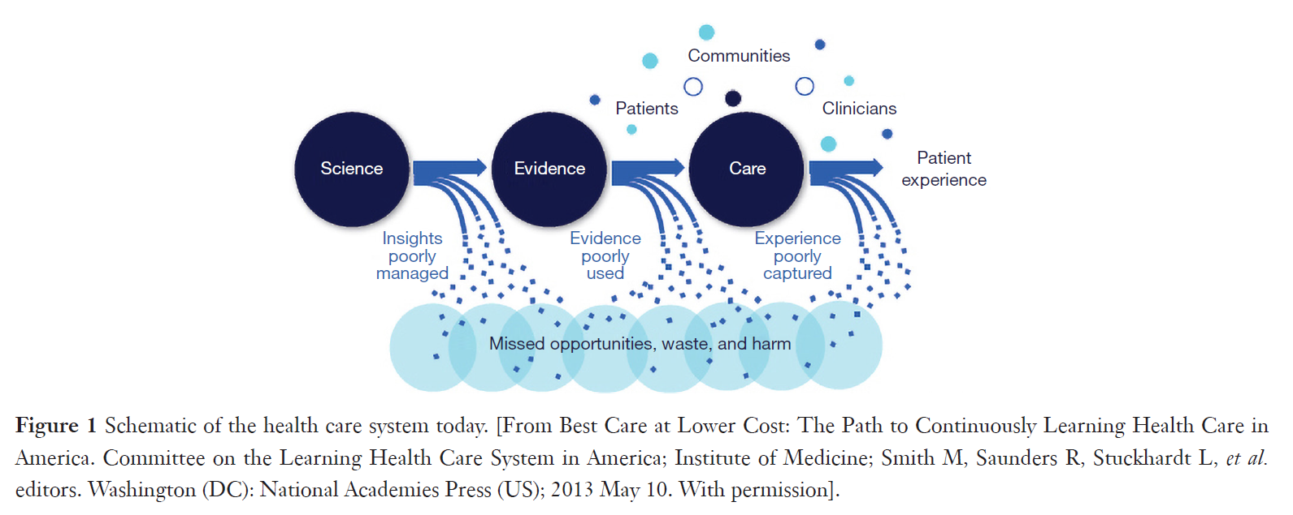
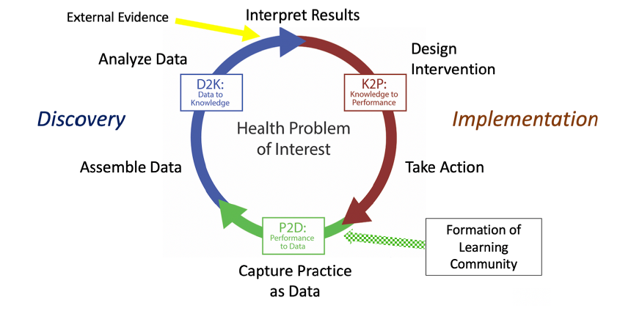

Learning Health Systems: Learning Faster
Peng, D, Rosenthal, D, Zafar F, et al. Collaboration and new data in ACTION: a learning health care system to improve pediatric heart failure and ventricular assist device outcomes. Translational Pediatrics, 2019 Oct; 8(4): 349–355.

Slide 17
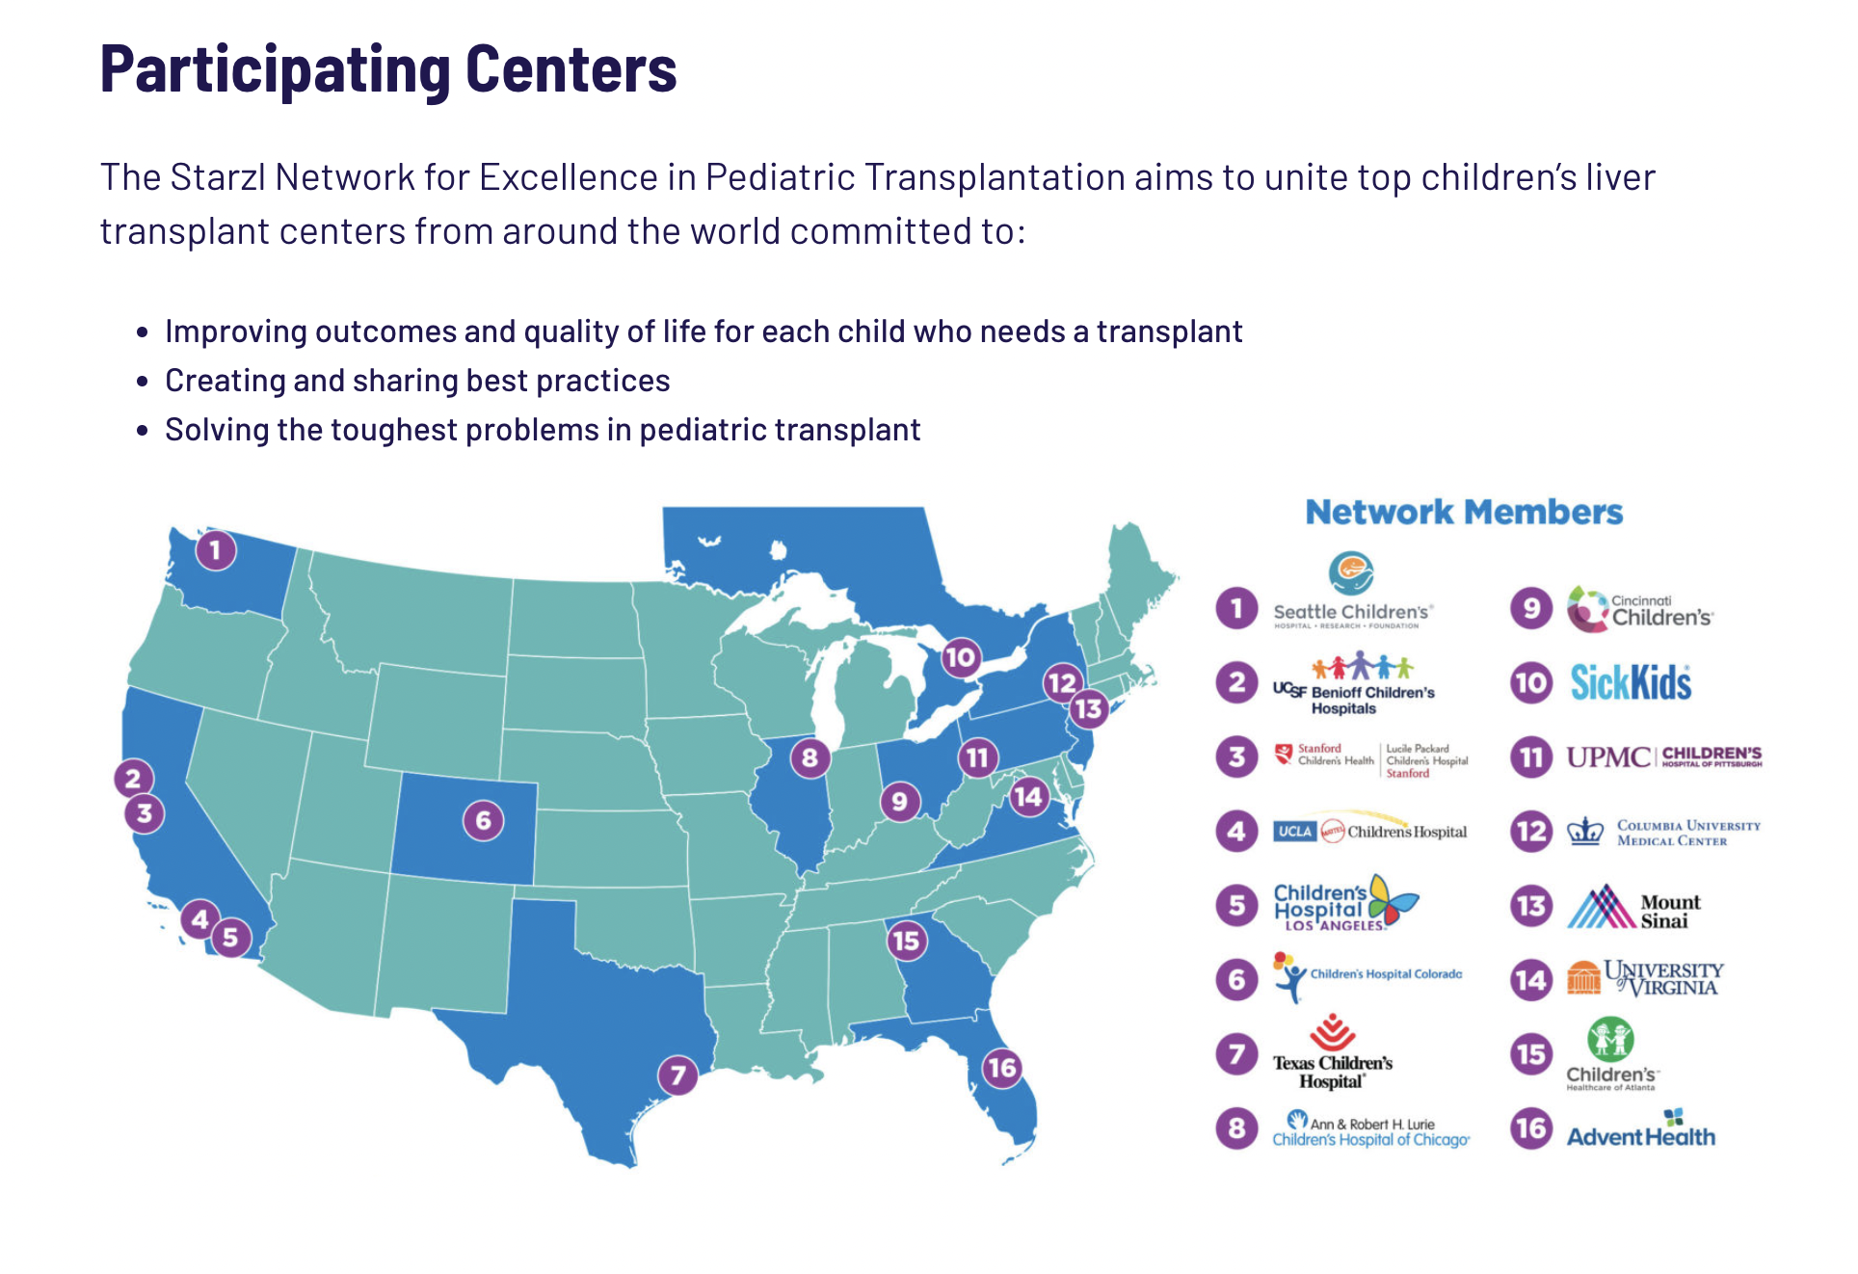


Slide 18

How will participating families – and the transplant community – learn about:
  Exactly what participating in the study will be like – what will happen during the study?
  What the project results are, and what they mean?
How will the project team make sure that communication about the study is clear, easy to understand, and from sources that families trust?
How will the confidentiality and personal information of participating children and families be protected in this project?
Sharing Information
How will this project help the lives and health of children and families who are participating in it?
How will the results of this project help future children with liver transplants and their families?
How does this project minimize the burden of participating on children and families? (including the burdens of pain, time, costs, and stress)
Is participating in the project “user-friendly” for patients and families?
Starzl
Guiding
Principles
Improving the Transplant Journey
Inclusive Partnership
How does this project address the priorities of pediatric liver transplant patients and families?
How are families and providers who are not doctors included as valued partners in each stage of this project?
How will this project be inclusive of a diverse group of pediatric liver transplant families and providers that is representative of the entire pediatric liver transplant community?
How will the contributions of participating children and families be recognized, during and after the project?
Personal communication E. Perito, J Squires et al, 10/2022

Slide 19

Starzl Network Guiding Principles
Collaboration
Transparency
Urgency
A desire among members to forgo individual gains in lieu of collective efforts.
A shared sense of determination to quickly and dramatically improve patient care and outcomes.
A willingness among members to freely and openly share data within and beyond the Network.
Equity
Continually striving to minimize financial, social, environmental, and racial inequities in access to and outcomes after liver transplantation.
Innovation
A determination to identify and use leading approaches and technologies to advance our goals.
Excellence
A commitment to engage leaders across multiple fields and combine their expertise.
Synergy
A drive to build off existing systems (e.g., SPLIT) or provide expertise to regulatory bodies (e.g., UNOS) who are advocating for improvement in outcomes for children.

Slide 20
Immune
Practice and Prospective trial design
Surgical
Key Events
Transition
How do we measure?
Quality of Life
Pediatric Liver Transplant QoL – can it be disseminated?
Prospective Priority Projects Starzl Network www.starzlnetwork.org

Slide 21
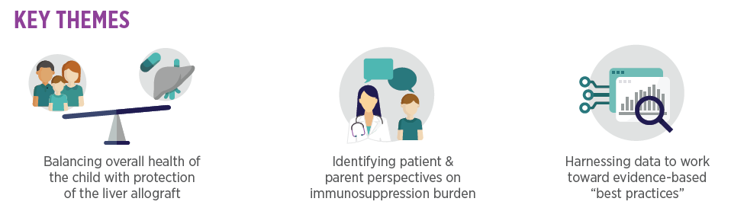
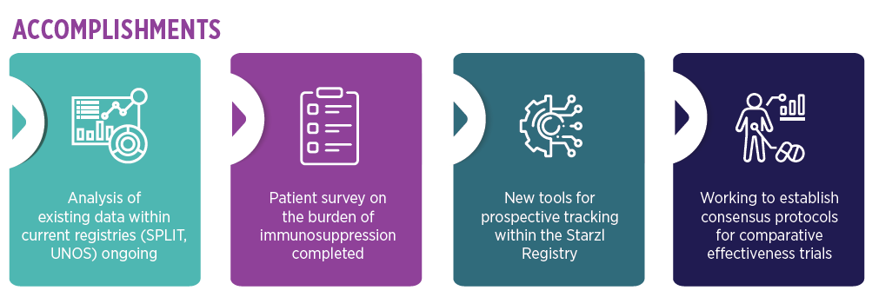
Optimizing Immunosuppression

Slide 22
Understanding Transition of Care
Key Themes
  Pediatric transplant recipients are at increased risk of rejection after transfer to adult care
  A multidisciplinary and standardized approach to transition of care requires effective collaboration between the youth, caregiver, pediatric team, and adult team
Goals
  Investigate patient outcomes through chart review to identify variables associated with optimal transfer of care.
  Establish guidelines and educational strategies for transitioning youth to adult care.
  Develop metrics and benchmarks to monitor a successful transition of care model.
Accomplishments
  Analysis of current state of transition within Starzl Network centers
  Initiated data collection looking at outcomes of liver transplant patients who were transferred adult care between 2013-2017
  Implemented dashboard and data collection to track transition to adult care

Slide 23
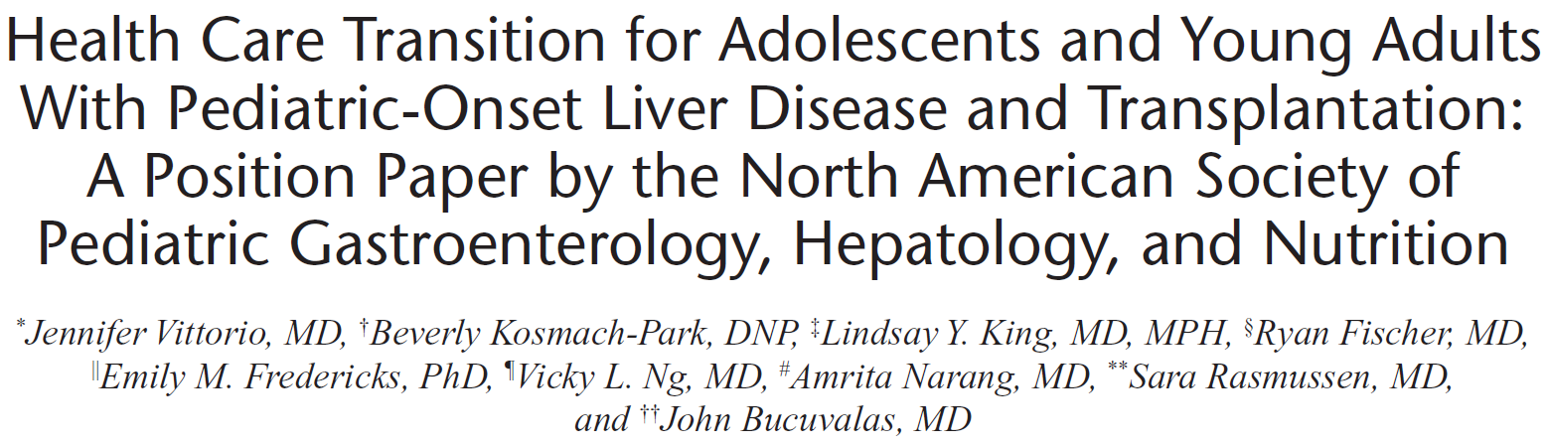
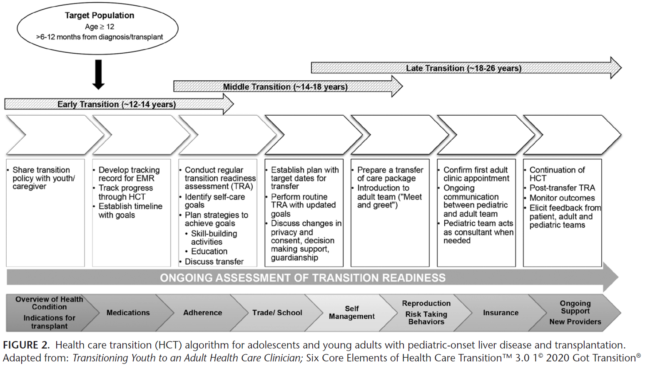

Slide 24
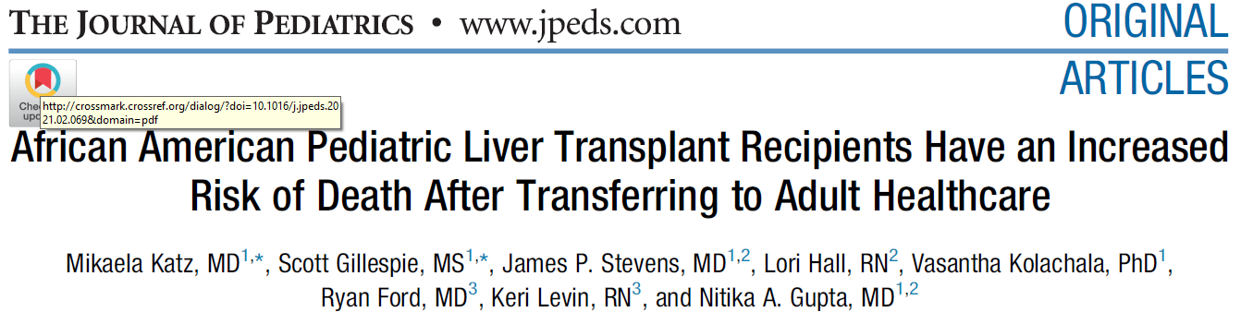
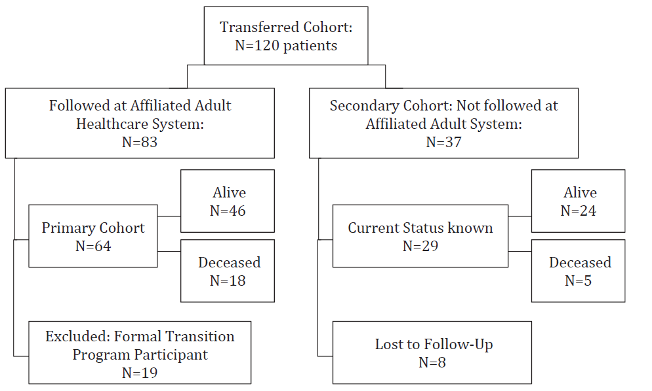

Slide 25
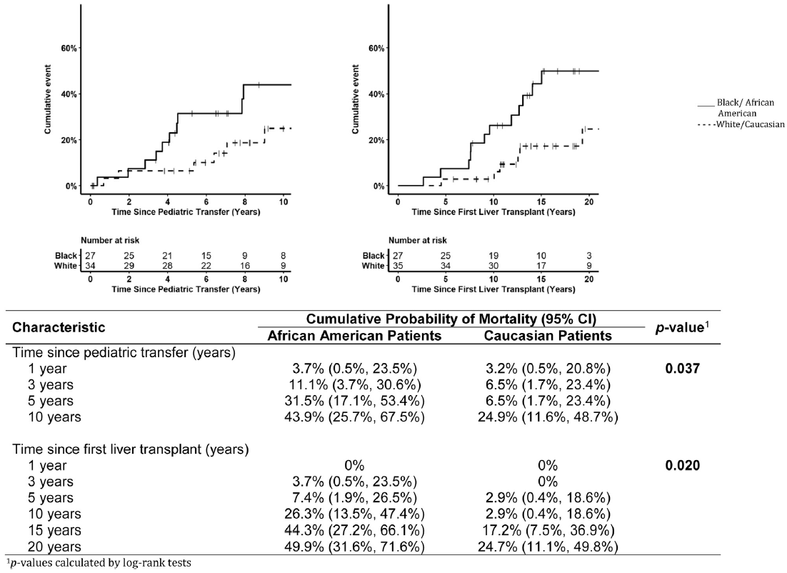
Overall mortality of the transferred patients was 28%
African American patients – 44% mortality
Average age at death post transplant -25 yrs

Slide 26
Long-term follow up and transition to adult providers

Slide 27
Success
Long-term patient and graft survival is expected after LT for MSUD
Children’s Hospital of Pittsburgh has ~50 patients transplanted for MSUD with >10 yrs
Many are young adults

Slide 28
Success
Long-term success hinges on appropriate care into adulthood and beyond
What are some medical challenges faced by adults after transplant?

Slide 29
Three areas of follow-up
Monitoring the liver graft
Monitoring Immunosuppression
Monitoring for malignancy

Slide 30
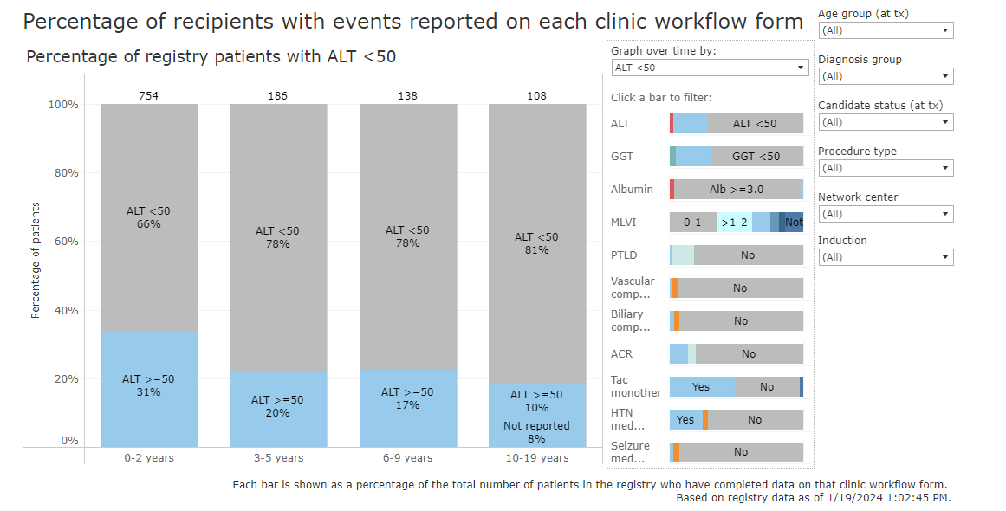
www.starzl.unosregistries.org

Slide 31
Where are we with monitoring the graft?

Slide 32
Where are we with monitoring the graft?
Taner, Timucin MD, PhD; Bruner, Julia BS; Emamaullee, Juliet MD, PhD; Bonaccorsi-Riani, Eliano MD, PhD; Zarrinpar, Ali MD, PhD. New Approaches to the Diagnosis of Rejection and Prediction of Tolerance in Liver Transplantation. Transplantation: May 16, 2022 - Volume - Issue - 10.1097/TP.0000000000004160

Slide 33
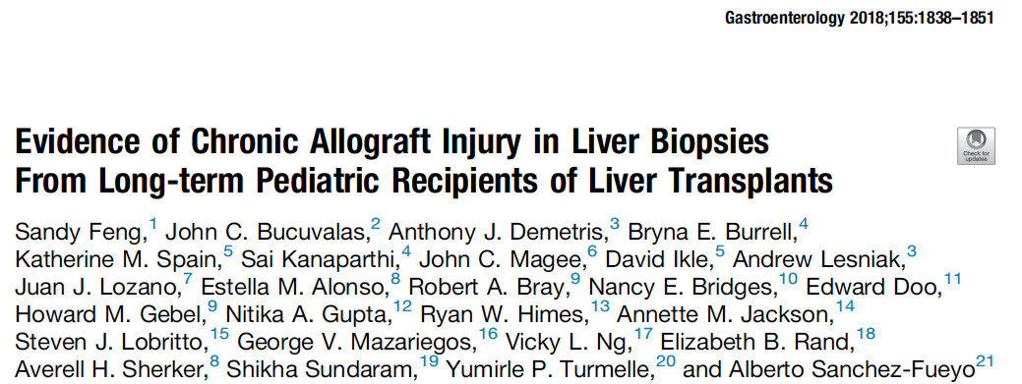
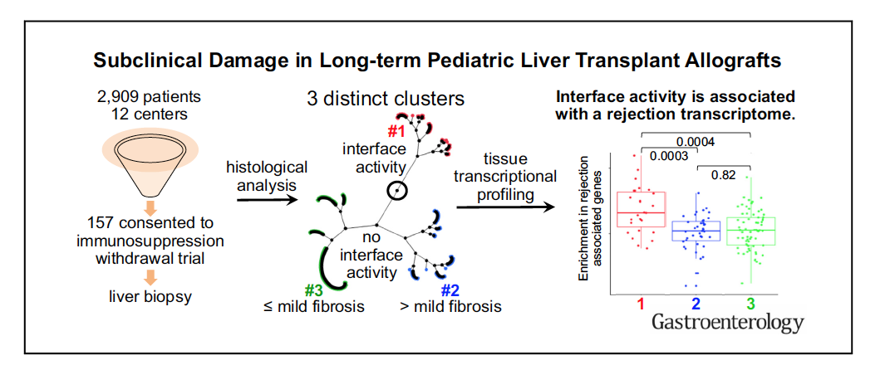

Slide 34
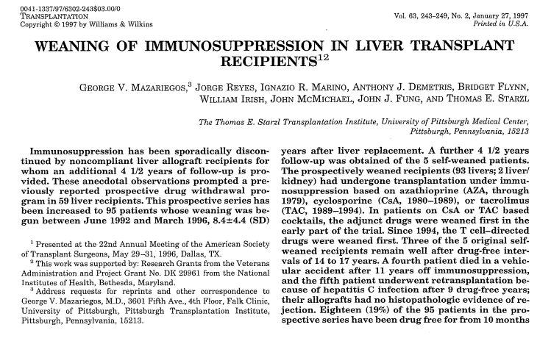
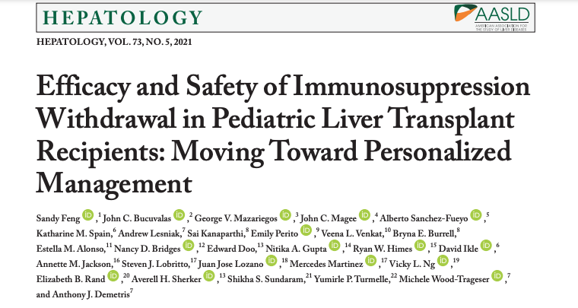
Status of Operational Tolerance
Multicenter IS trial, iWITH (NCT01638559)
PITT IS weaning trial, 1992-1996

Slide 35
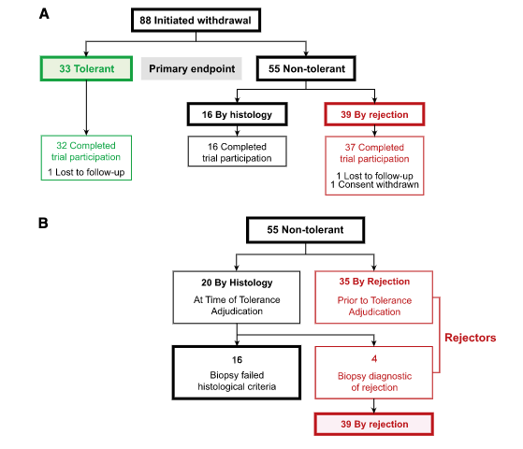
Inclusion criteria
Liver Tx at </=6 years of age
>4 years post transplant
<Age 18 at enrollment
ALT, GGT </==50 U/L
Lack of acute or chronic rejection in last 2 years
Calcineurin monotherapy
Eligible screening biopsy
Non automimmune disease or HCV/HBV
Retransplant
Hepatology, Vol 73 (5), 2021

Slide 36
Monitoring IMMUNOSUPPRESSION

Slide 37
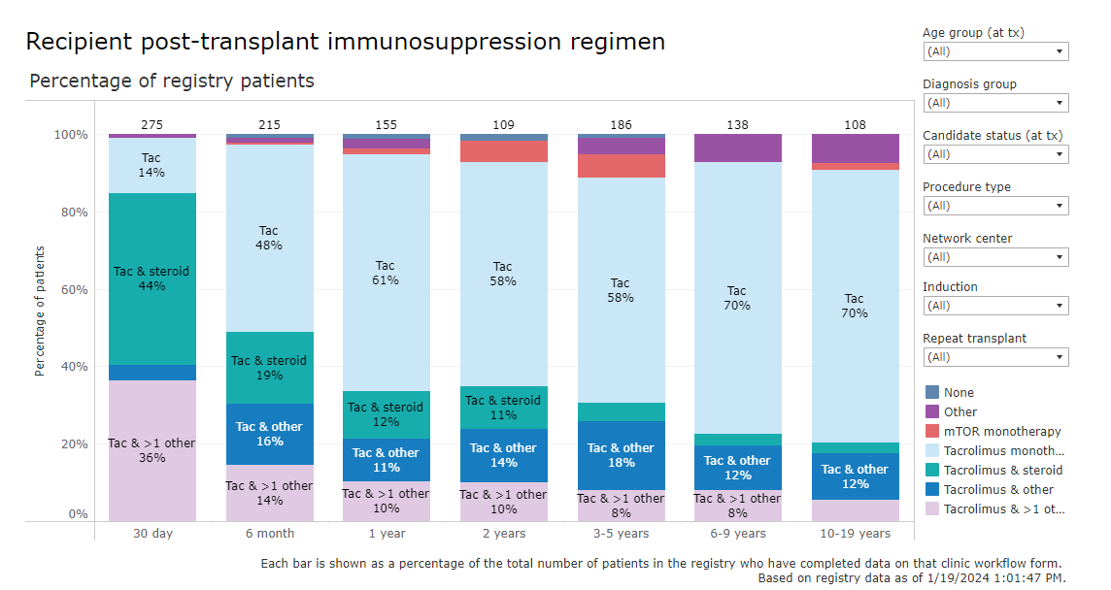
www.starzl.unosregistries.org

Slide 38
Cancer risk of immunosuppression
EBV-related tumors
  Used to be the hot-topic and large source of late mortality
  EBV related post-transplant lymphoproliferative disease is now rare with close follow up of quantitative EBV viremia with PCR and adjustment of immunosuppression

Slide 39
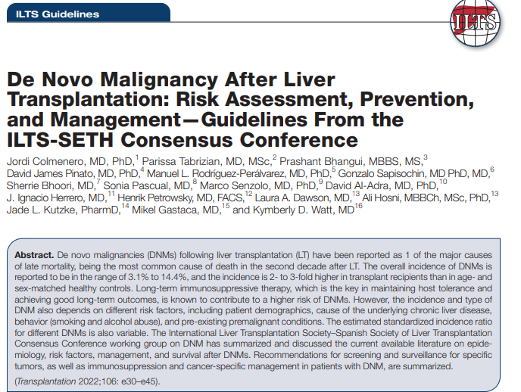

Slide 40
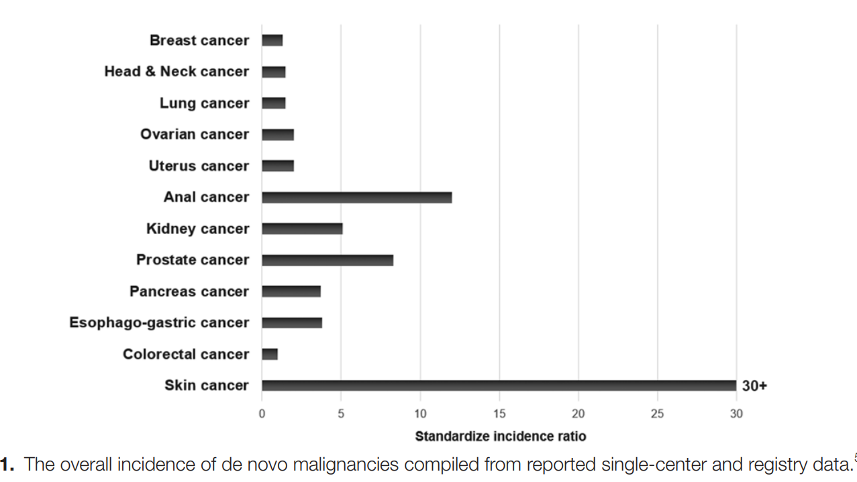
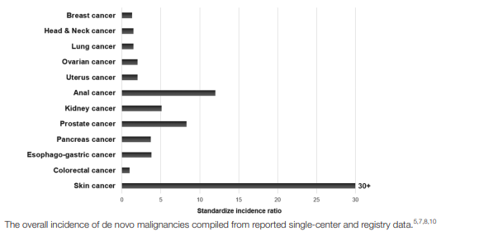

Slide 41
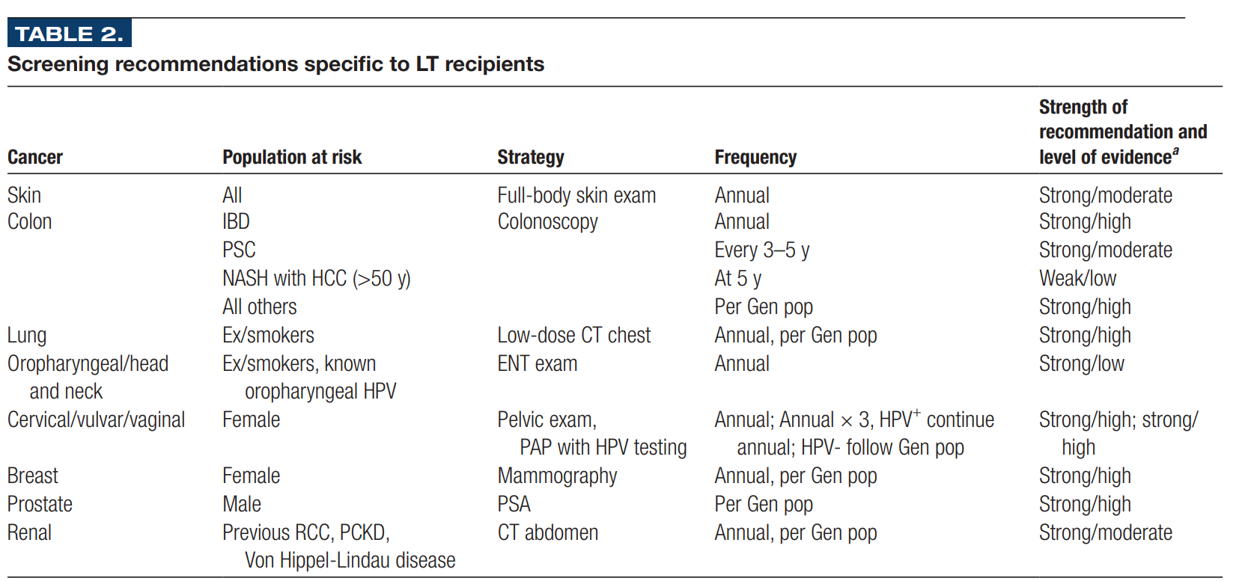

Slide 42
Other life-long considerations
Hypertension
Renal insufficiency
Dyslipidemias/ hypercholesterolemia
Diabetes/ insulin insensitivity
Fertility and prenatal care
Management of pre-existing conditions
  Mental health
  Seizure disorders

Slide 43
Prevention – long term
Life-long follow-up is needed
Proper transition to adult care is 100% needed
  Complex patients
  Multiple care-takers
  Loss to followup is associated with increased graft loss and death
Starzl Network working group
CHP process

Slide 44
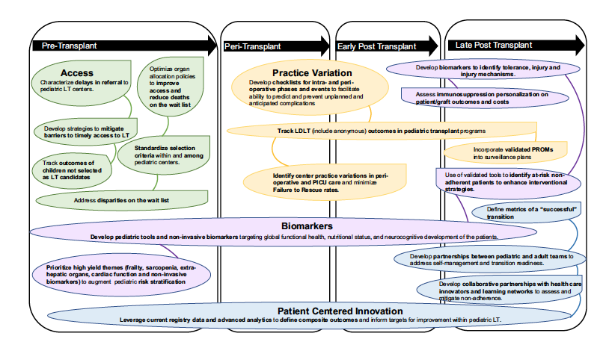
The challenges of MSUD s/p Tx mirror the pediatric journey post LTX
Pediatric Transplantation, ( 23) Issue: 6, 25 July 2019, DOI: (10.1111/petr.13537)

Slide 45
Conclusions
The outlook for exceptional long term outcomes in liver Tx at our center is excellent
Variation in outcome across centers should be expected
Ideal outcome metrics are favorable for MSUD Tx
Improvements in graft and immune monitoring and adherence/transition should be expected to further improve outcomes

Slide 46
Conclusions
The success of liver transplant as a mode of treatment for patients with MSUD has resulted in a growing population of young adults who need life-long care and management
Proper transition to adult care is needed to fully realize the benefits of liver transplantation
  Health screening
Current work is on focusing increasing collaboration among teams to optimize care for the long term

Slide 47
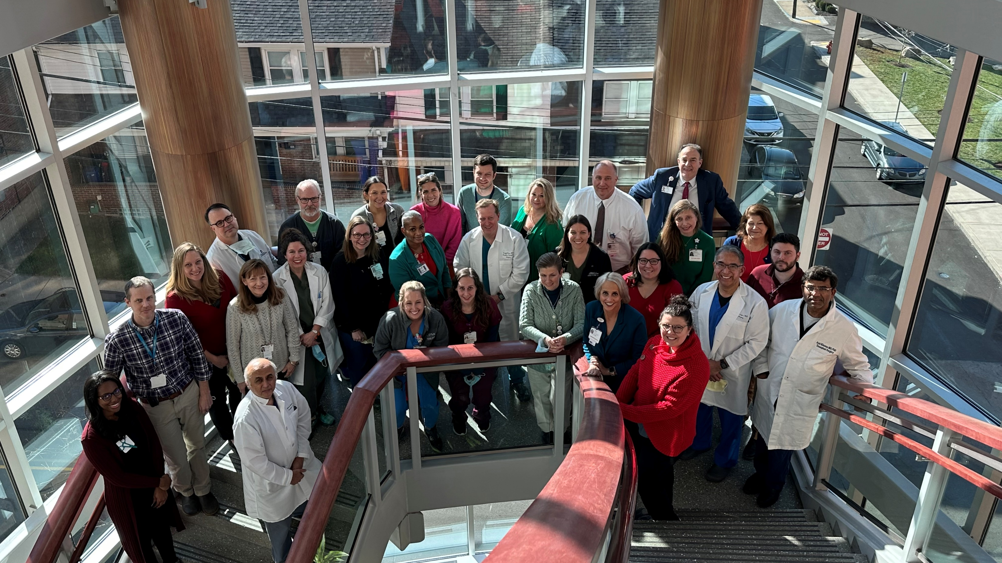

Slide 48
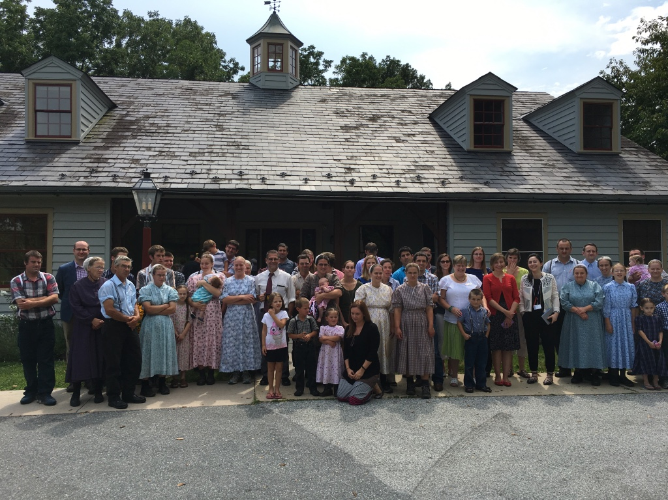
ACKNOWLEDGEMENTS

Slide 49
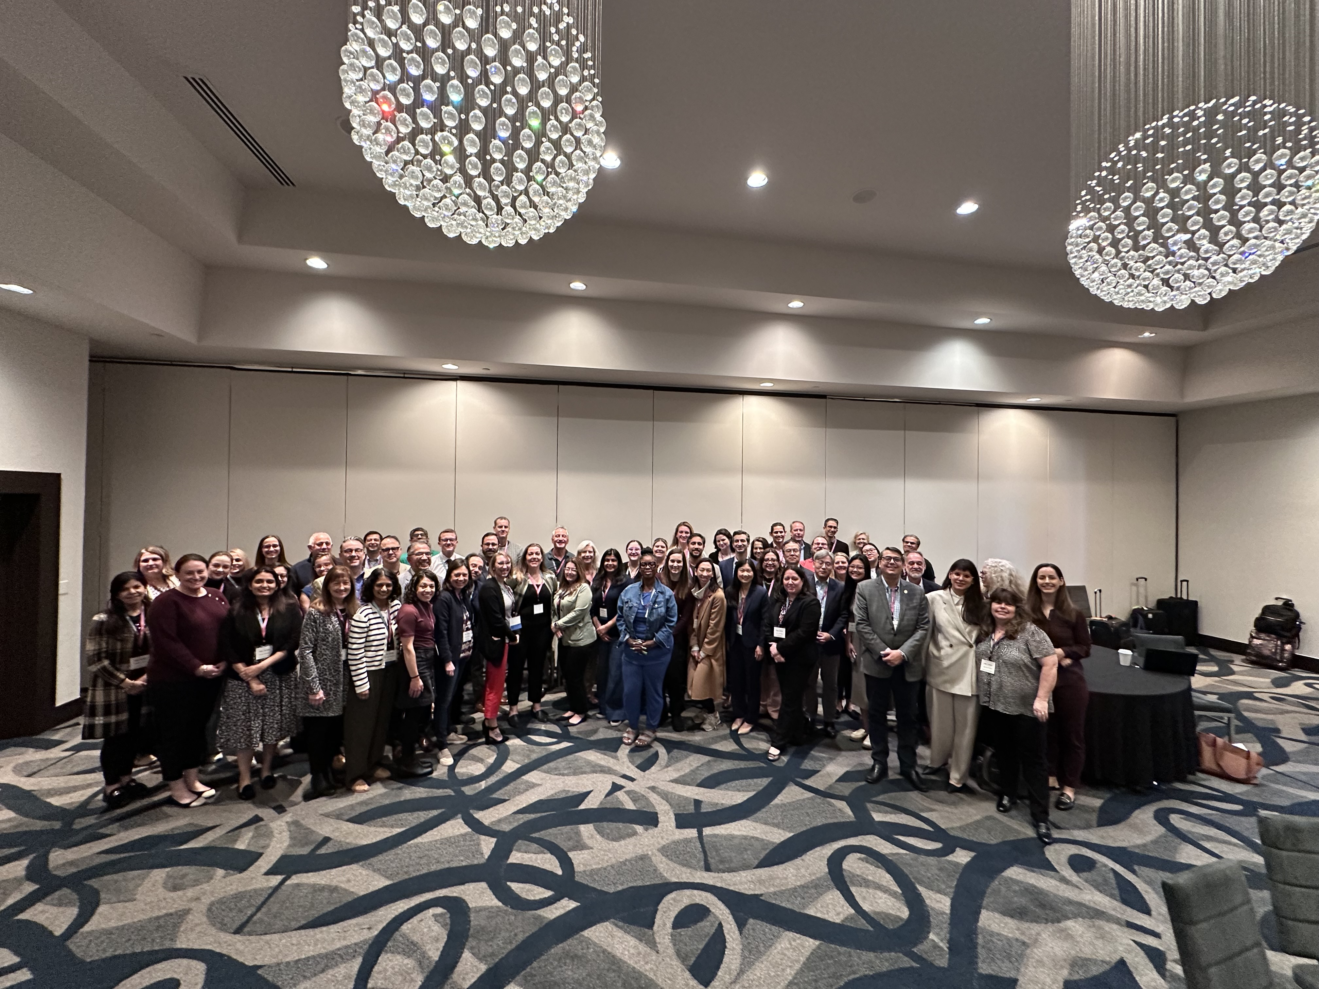
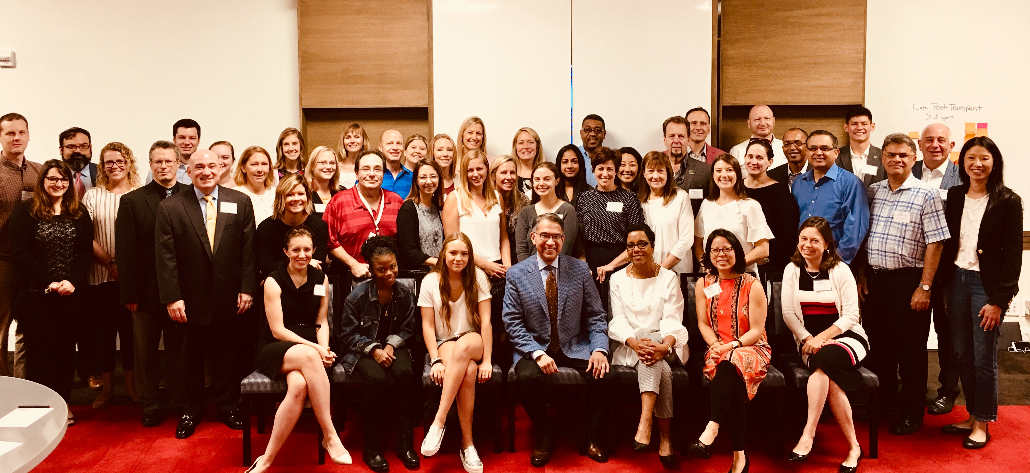
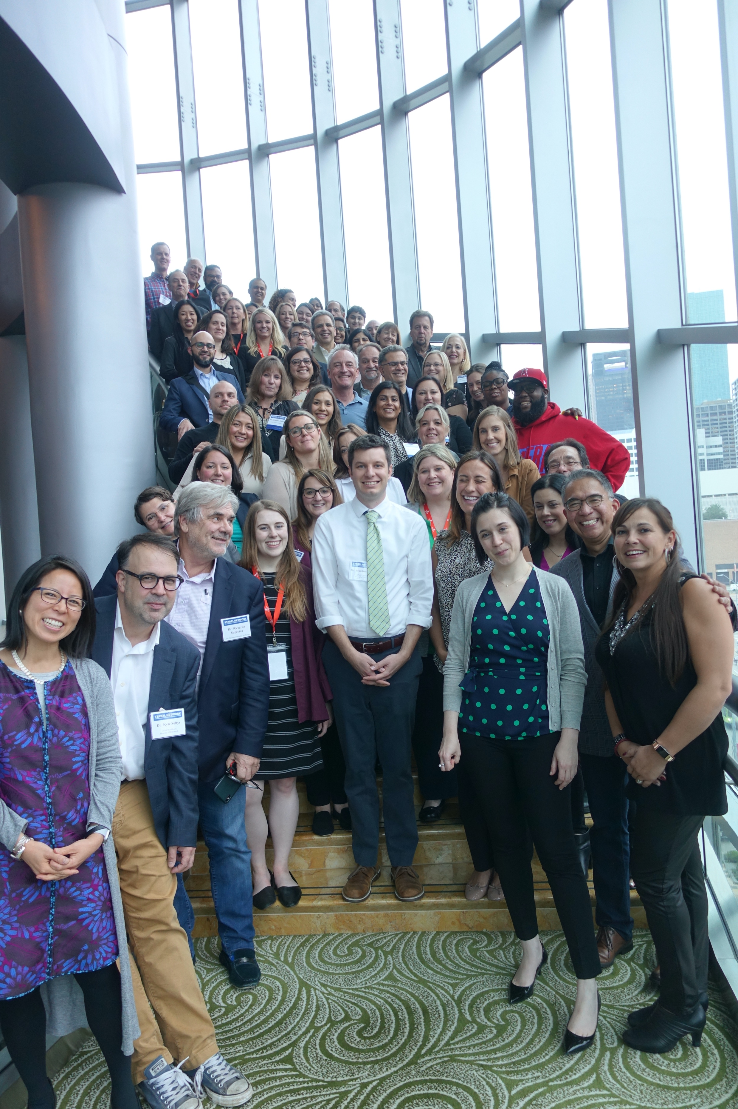
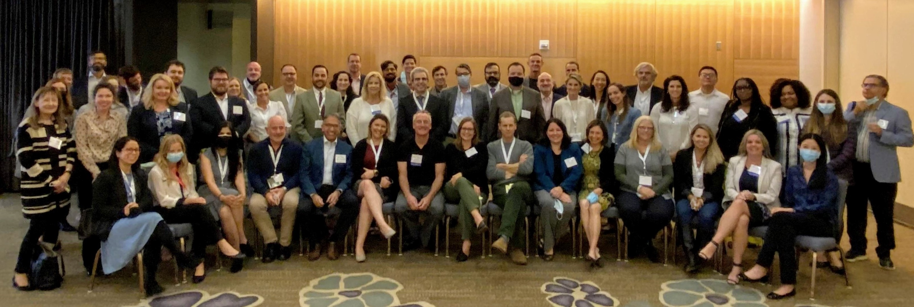
Starzl Network Team

Slide 50
DISCUSSION

